Slide 1
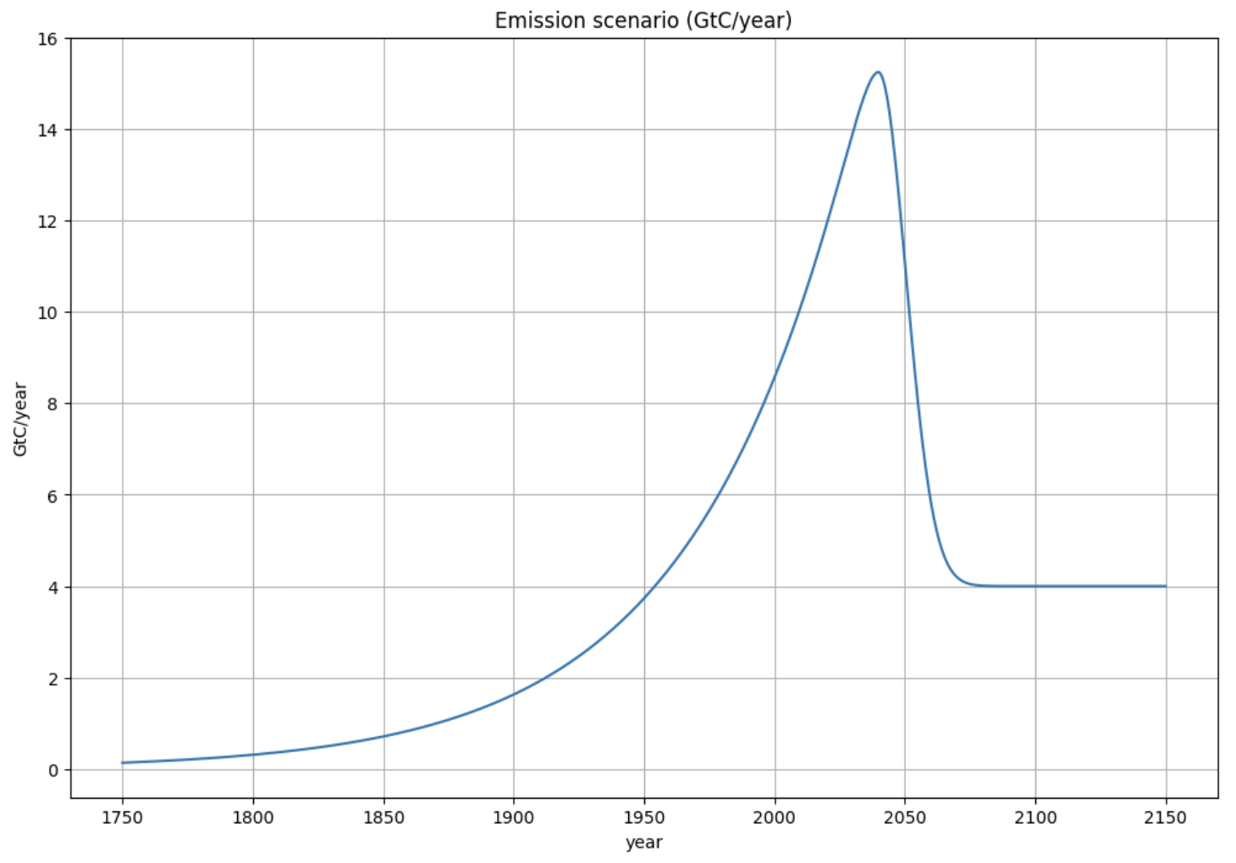
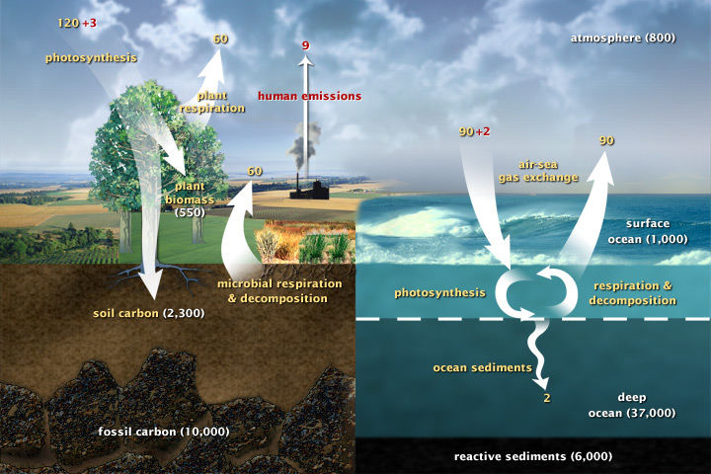
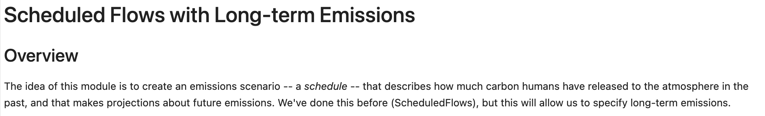
Long-term emissions

Slide 2
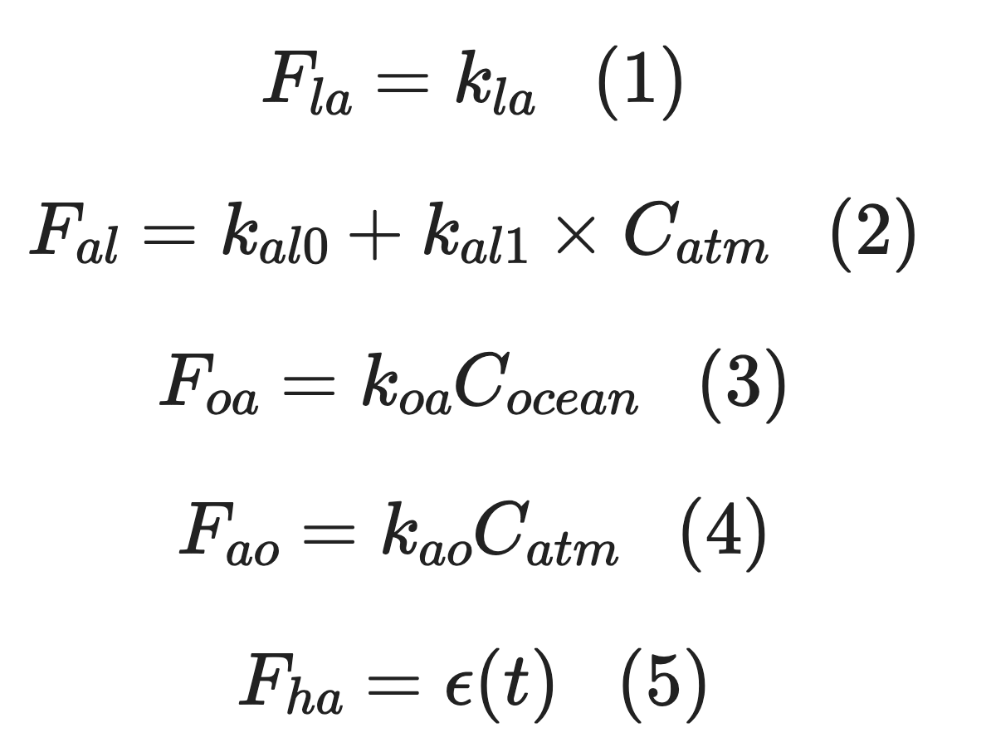
Cambio 1.0 fluxes
We’re assuming a constant non-anthropogenic land-to-atmosphere flux

Slide 3
Cambio 1.0 fluxes
This models $CO_{2}$ fertilization

Slide 4
Cambio 1.0 fluxes
The more concentrated $CO_{2}$ is in the water, the faster it will come out!

Slide 5
Cambio 1.0 fluxes
The more concentrated $CO_{2}$ is in the air, the faster it will go into the ocean!

Slide 6
Cambio 1.0 fluxes
We know how to use ScheduledFlows and ScheduledFlowsLTE to make this

Slide 7
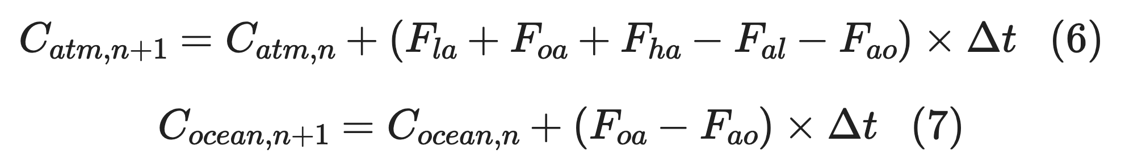
Cambio 1.0 puts those fluxes into an Euler loop
Inside an Euler loop (like the loop you made in SimpleRadiativeBalance:

Slide 8
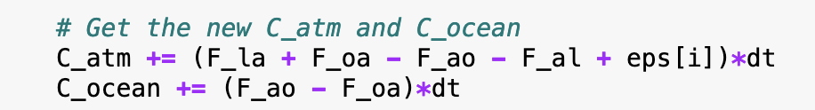
Cambio 1.0 puts those fluxes into an Euler loop
Inside an Euler loop (like the loop you made in SimpleRadiativeBalance:

Slide 9
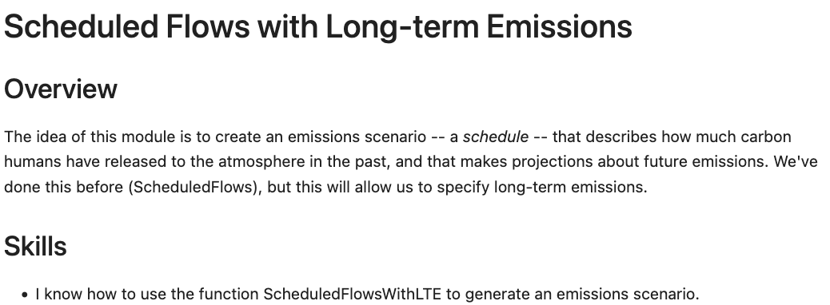
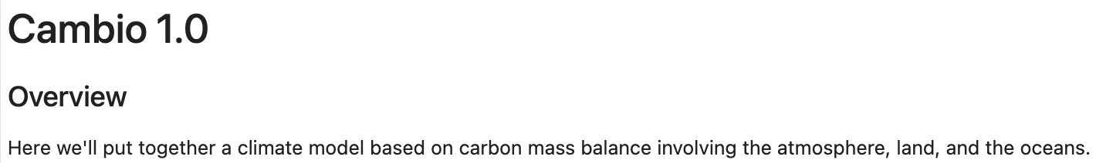
OK, let’s get started

